Slide 1
New Data Model Training – Session 1
Audience: AArete MCS

Slide 2
Introduction
Necessity of Evolution: AArete has commenced a transformative journey with the creation of Payment Intelligence 2.0 (PI20), which necessitates transitioning from our longstanding enterprise claims data model for medical and RX to a more advanced version. This initiative is in line with our dedication to leveraging innovative solutions for effective healthcare data management and analysis.
Transition to New Data Model: With over two years of devoted development, we are now integrating the new enterprise claims data model across our service lines. This key strategic move ensures a seamless transition of all client data, existing and new, to the updated model, thereby augmenting our analytics, insights, and the overall value we offer to our healthcare clients.
Immediate Impact and Future Readiness: The adoption of the new data model is effective immediately for medical claims, while the transition for RX claims is expected by the end of 2024. Training is critical to equip our team with the necessary knowledge and competencies to efficiently manage this transition, uphold our service excellence, and meet the evolving needs of healthcare data analytics.
Notes:
This training is pivotal for AArete’s team to understand the technical and procedural nuances of the new enterprise claims data model for medical and RX. By embracing this change, we not only align with the innovations brought by PI20 but also enhance our operational efficiency and data analysis capabilities. It's crucial for maintaining our competitive edge and fulfilling our commitment to delivering exceptional consulting services to our healthcare clients.

Slide 3
Review Original Medical Claims Data Model
Introduction to New Data Model
Walkthrough New Schemas
Custom Fields
Walkthrough of New Tables
Detailed Walkthrough of Key Differences
Join Comparison between 2 Data Models
SQL Script Adaptation Example
Field Name changes
VARCHAR Comparison Change
How To Get Started in New Environment
Support with Transition to New Platform

Slide 4
Training Objectives
Understand the Data Model Differences
Recognize the differences between the various schemas
Understand the new tables and how they differ from the prior model
Distinguish the key differences between original and new data model
Know how to get support during the transition process

Slide 5
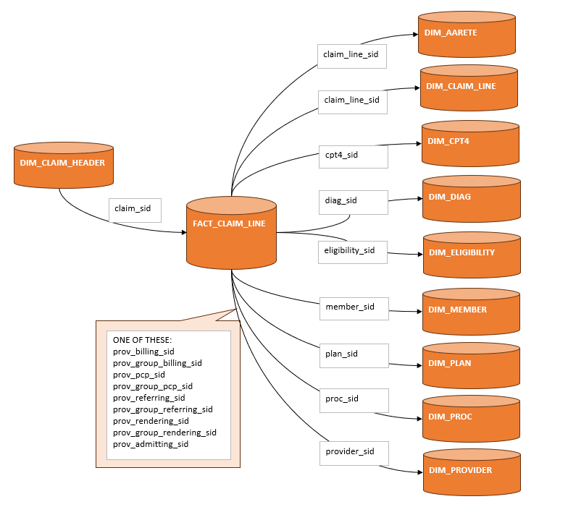
Prior Medical Claims Data Model

Slide 6
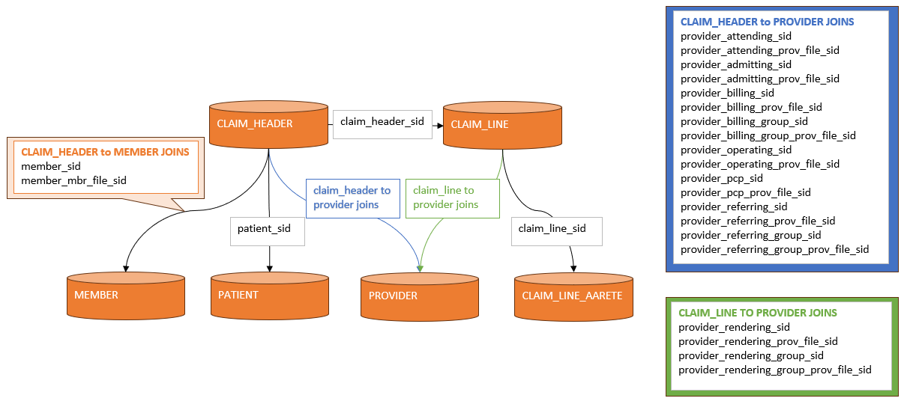
New Medical Claims Data Model

Slide 7
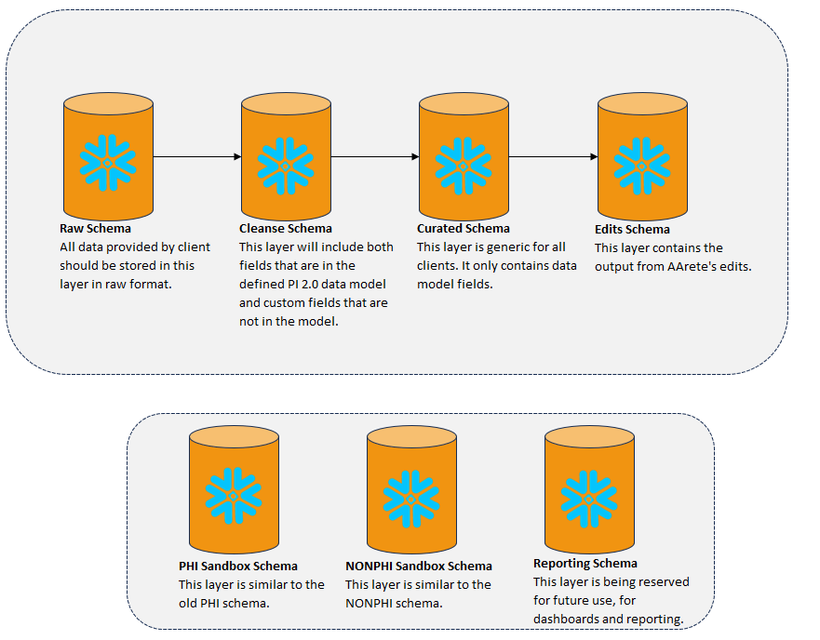
New Schemas

Slide 8
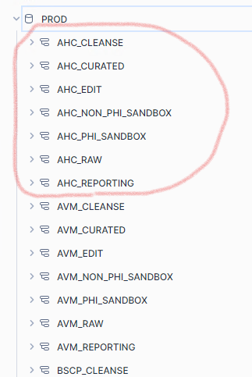
New Schemas
Project team members will use the role PROD_[CLIENT_NAME]_PHI_ANALYTIC for their work
This will give READ access to the PROD database of your client.
It will also give READ/WRITE access to PHI and NONPHI sandboxes. This means you can create tables.
For most analysis, the tables in the CLEANSE schema will be the primary source.
However, the CLAIM_LINE_AARETE table is only in the CURATED schema. You can join the CLAIM_LINE_AARETE table from CURATED to your CLAIM_LINE table in CLEANSE using the CLAIM_LINE_SID.

Slide 9
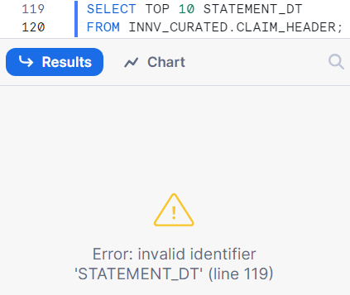
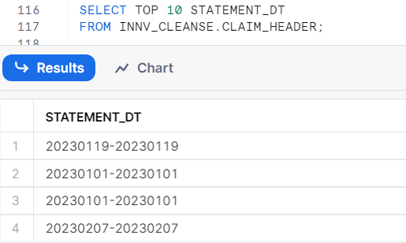
Custom Fields
The curated layer remains consistent across all databases and clients, whereas the cleanse layer contains custom fields specific to each client.
STATEMENT_DT is not a standard field in the CURATED layer. Therefore, you will not be able to select that field from that schema.

Slide 10
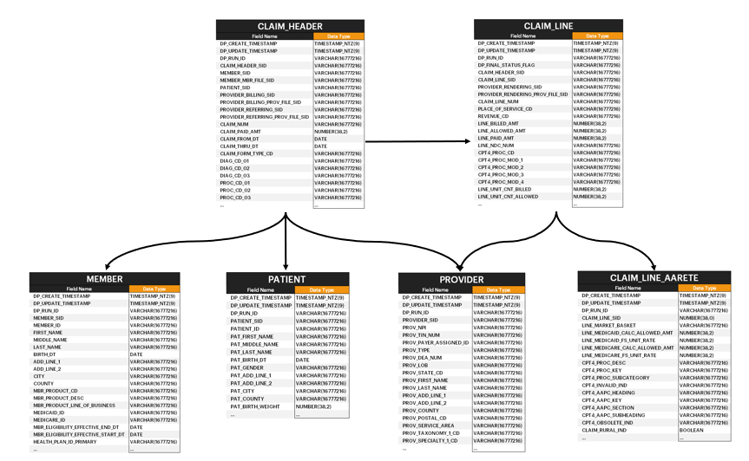
New Tables - Overview
In the New Data Model, a reduced number of tables are utilized, resulting in better query performance and fewer joins needed
Each table will hold the below fields:
DP_CREATE_TIMESTAMP
DP_UPDATE_TIMESTAMP
DP_RUN_ID

Slide 11
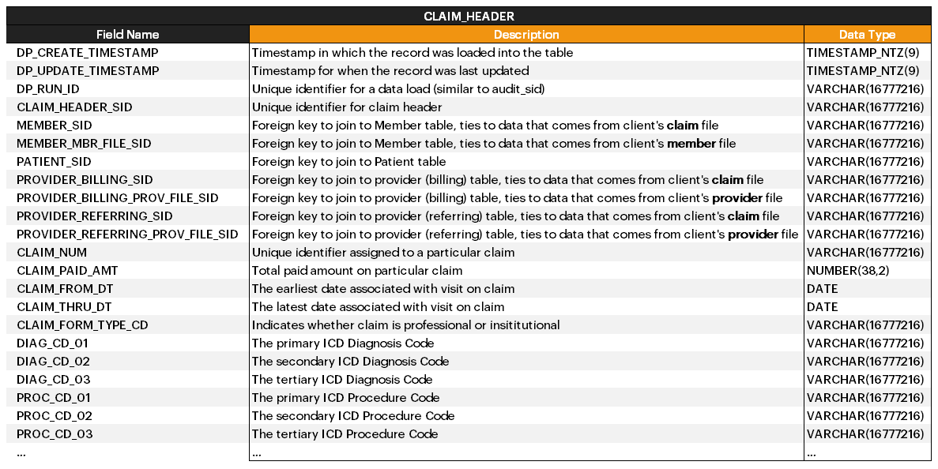
Claim Header
Diagnosis and procedure codes are now held at the header level, rather than their own respective tables.

Slide 12
MEMBER_SID and MEMBER_MBR_FILE_SID
In the new data model, we are keeping both the member data from the raw member files and the member data from the raw claim files.
If you are interested in member data that was sourced from the claim file data, join the MEMBER table to the CLAIM_HEADER table using the MEMBER_SID. If you need the member data sourced from the member file, join the MEMBER table to the CLAIM_HEADER table using the MEMBER_MBR_FILE_SID.
Same is true for provider data. If you want provider data that was sourced from the claim file data, join the PROVIDER table to the CLAIM_HEADER table using the PROVIDER_[ROLE]_SID. If you need the provider data sourced from the provider file, join the PROVIDER table to the CLAIM_HEADER using PROVIDER_[ROLE]_PROV_FILE_SID.

Slide 13
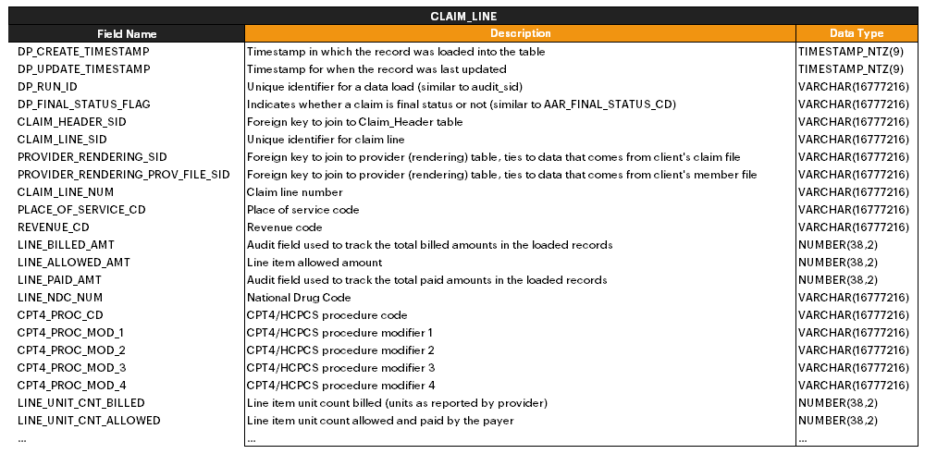
Claim Line
In the updated model, rendering provider SID is in the claim line table.
All other provider SIDs are now located in the claim header table.
CPT4 codes are now held at the line level, rather than its own respective table.

Slide 14
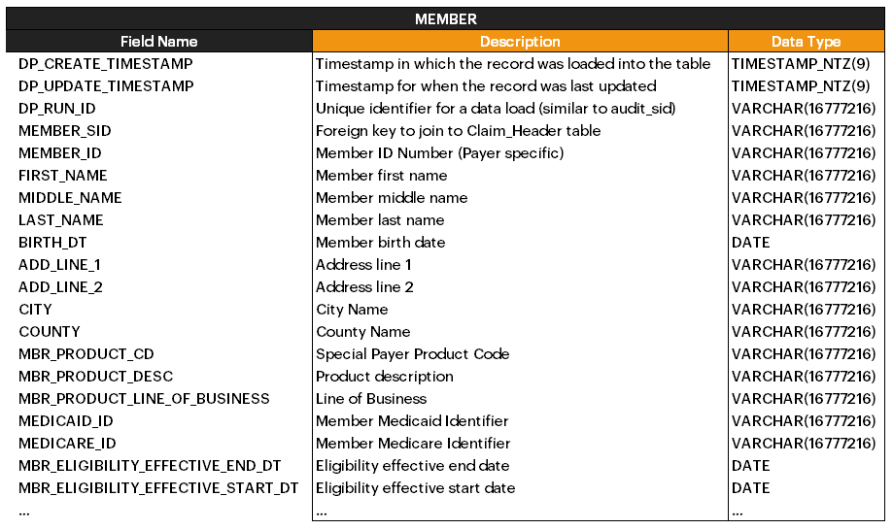
Member
Plan information is now in the member table.

Slide 15
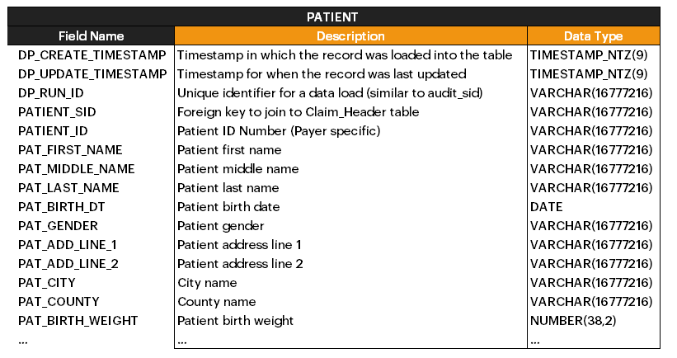
Patient

Slide 16
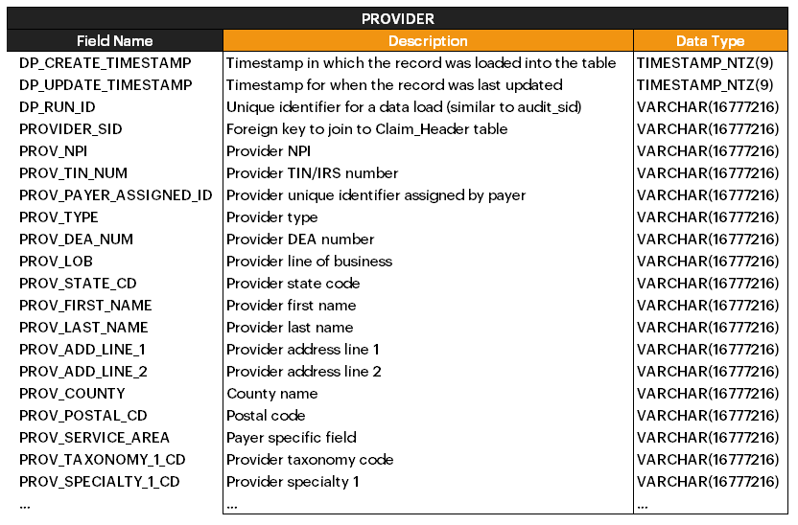
Provider

Slide 17
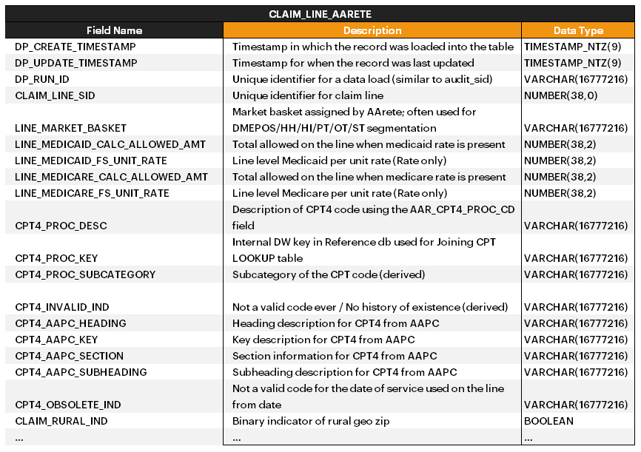
Claim Line AArete
These CPT4 fields used to be held in DIM_CPT4 table. They are now in the CLAIM_LINE_AARETE table

Slide 18
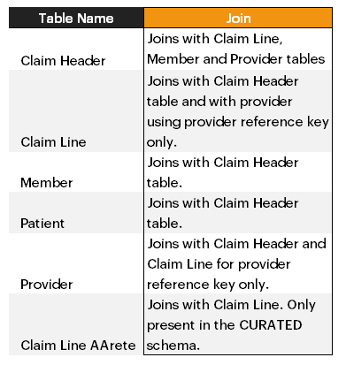
New Tables and Join Summary
In the New Data Model, a reduced number of tables are utilized, resulting in better query performance and fewer joins needed
DIM_DIAG, DIM_PROC, DIM_CLAIM_HEADER > CLAIM_HEADER table
DIM_ELIGIBILITY, DIM_PLAN, DIM_MEMBER > MEMBER table
DIM_CPT4, DIM_CLAIM_LINE, FACT_CLAIM_LINE > CLAIM_LINE table
Please remember, CLAIM_LINE_AARETE is only present in the CURATED schema. So, while in most analysis you will use the tables in the CURATED schema, you will always have to get CLAIM_LINE_AARETE fields from the CURATED schema.
Notes:
DP_CREATE_TIMESTAMP – that is the timestamp in which the record was loaded into the table
DP_UPDATE_TIMESTAMP- timestamp for when the record was last updated (received new data file that had updated data for that record)
DP_RUN_ID- unique identifier for a data load (similar to audit sid)
DP_ACTIVE_RECORD_FLAG- currently not using this for anything

Slide 19
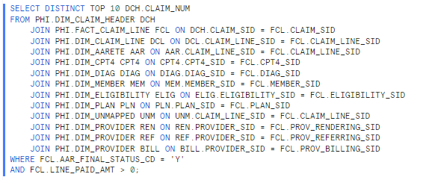
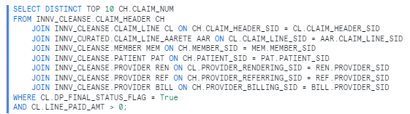
Prior Data Model Joins VS New Data Model Joins
As you can observe, there are fewer joins in the new data model. Additionally, it's important to reiterate that RENDERING provider data is located at the line level, whereas all other provider types are situated at the claim level.
Also, note that CLAIM_LINE_AARETE is coming from the CURATED schema; it does not exist in the cleanse schema.

Slide 20
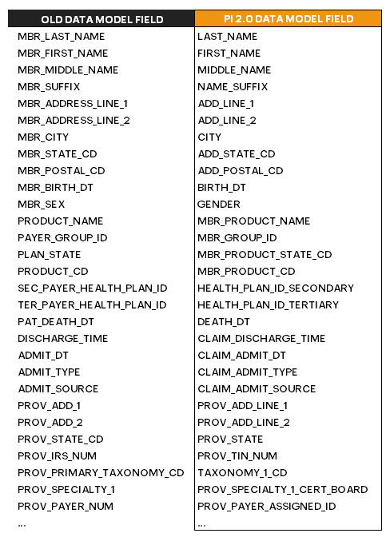
Field Name Changes
It’s essential to acknowledge that there have been alterations in field names between the previous data model and the new data model.
Field name changes will be reflected in CLIENT crosswalks for any client that has been migrated from the prior data model to the new data model
For any client that is transitioned there will be a client specific field name crosswalk located in the PHI SANDBOX schema for use when converting your existing code
SELECT * FROM [CLIENT_ID]_PHI_SANDBOX.FIELD_NAME_CROSSWALK;
To understand how NEW onboarded clients are mapped to the new data model, use the following query:
SELECT * FROM CONFIGURATION.CROSSWALK WHERE CLIENT_ID = [CLIENT_ID];

Slide 21
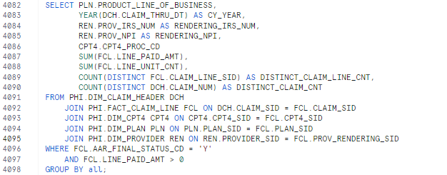
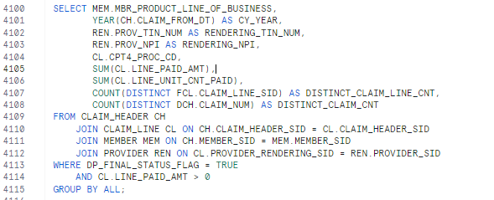
SQL conversion from Prior to New data model
Some field names have changed
The joins used are different
As can be seen in this example, there have been changes in field names, table names, and table relationships.
AAR_FINAL_STATUS_FLAG > DP_FINAL_STATUS_FLAG

Slide 22
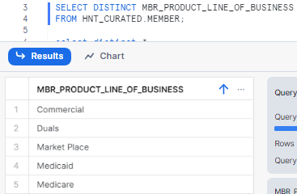
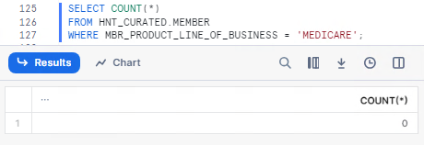
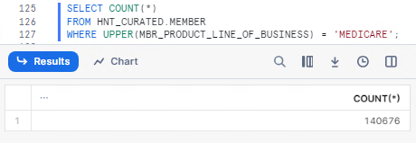
Essential Functions for VARCHAR Comparison
If you include a field with a data type of VARCHAR, you NEED to use the UPPER() or LOWER() functions in your query.
The inclusion of 'UPPER' enabled us to precisely identify members with Medicare Line of Business. Alternatively, we could have utilized 'WHERE LOWER(MBR_PRODUCT_LINE_OF_BUSINESS) = 'medicare’.
In our prior data model, you did not have to use this function, but the new data model stores data in a case sensitive way, and it is critical to utilize UPPER or LOWER functions to get the proper result.

Slide 23
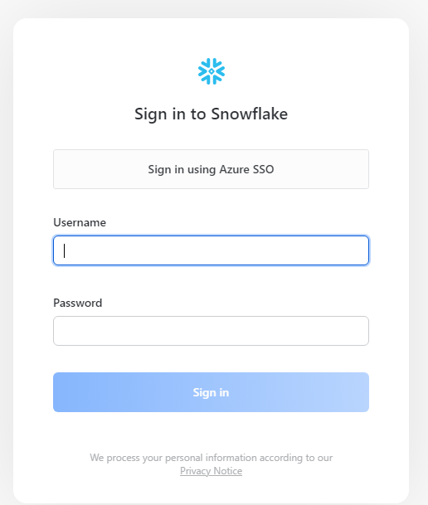

Role and Warehouse
Steps for logging into PI Snowflake Instance
Log in to VPN
Log in to RDS
Open up AArete PI Snowflake
Click on ‘Sign in using Azure SSO’
Set Role to PROD_[CLIENT_NAME]_PHI_ANALYTIC

Slide 24
Key Takeaways

Slide 25

How to Get Help
For support writing and converting SQL for the new data model, reach out to Meena Taneja’s team by emailing your request to pod1@aarete.com
For any potential data-related issues, reach out to the IT Data Architecture and Engineering team by emailing your request to dae@aarete.atlassian.net

Slide 27
Appendix

Slide 28
Key Takeaways - Detail
In the new data model, fewer tables are utilized, with greater fields per table, resulting in fewer joins
Attributes from DIM_DIAG, DIM_PROC, DIM_CLAIM_HEADER are now found in the CLAIM_HEADER table
Attributes from DIM_ELIGIBILITY, DIM_PLAN, DIM_MEMBER are now found in the MEMBER table
Attributes from DIM_CPT4, DIM_CLAIM_LINE, FACT_CLAIM_LINE are now found in the CLAIM_LINE table
In the prior model, all provider SIDs were stored in the line level fact table.
In the new model, the rendering provider SID remains in the claim line table. All other provider SIDs are now found in the header level table.
In the new data model, there are now two member sids and two provider sids (per role) in the header. The purpose is to keep both the data sourced from the raw member/enrollment/provider files and the member/enrollment/provider data sourced from the raw claim files.
If you are interested in member data that was sourced from the claim file data, join the MEMBER table to the CLAIM_HEADER table using the MEMBER_SID. If you need the member data sourced from the member file, join the MEMBER table to the CLAIM_HEADER table using the MEMBER_MBR_FILE_SID.
CLAIM_HEADER.MEMBER_SID=MEMBER.MEMBER_SID
CLAIM_HEADER.MEMBER_MBR_FILE_SID=MEMBER.MEMBER_SID
Same is true for provider data. If you want provider data that was sourced from the claim file data, join the PROVIDER table to the CLAIM_HEADER table using the PROVIDER_[ROLE]_SID. If you need the provider data sourced from the provider file, join the PROVIDER table to the CLAIM_HEADER using PROVIDER_[ROLE]_PROV_FILE_SID.
CLAIM_HEADER.PROVIDER_[ROLE]_SID=PROVIDER.PROVIDER_SID (CLAIMS SOURCE)
CLAIM_HEADER.PROVIDER_[ROLE]_PROV_FILE_SID=PROVIDER.PROVIDER_SID (PROVIDER FILE SOURCE)

